Slide 1

DriverPass System Analysis
Dustin Runkel
Notes:
[No speaker notes required for this slide.]

Slide 2

System Requirements
Functional Requirements:
The system shall store and provide learning materials
The system shall have a method to schedule and store appointments
Non-Functional requirements:
Scalability - the system should be able to handle the workload/users on it
Accessibility-The system should be available on any device that supports a web browser.
Notes:
When we think of DriverPass, we want a few things to be part of the end-user experience, these include things driverpass needs to do, as well as how driverpass should behave. DriverPass should be able to store our learning content, and provide it to students, that is very important. Also, driverpass should be able to help students schedule appointments, these two ideas in general encompass what DriverPass is supposed to be. As for the behavior of driverpass, we need it to scale with the amount of users, and a user should have ease of access to driverpass.

Slide 3
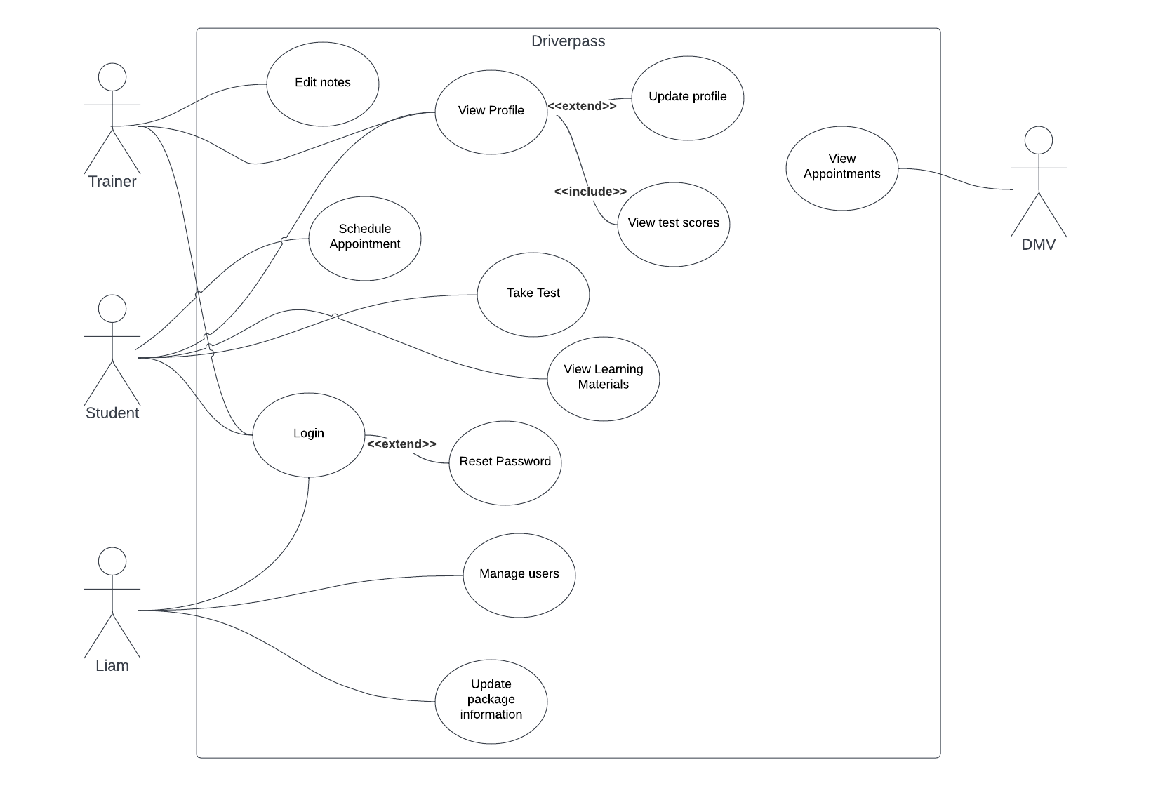
Use Case Diagram
Notes:
Who is going to use DriverPass? Well, that is a good question. Students, Trainers, the DMV, and of course Mr. Liam. This diagram may be confusing, but it is just a way to describe who can interact with DriverPass, and what they should be able to do. The bubbles are things a user can do. If you notice the login, everyone has an interaction with our login page, which is very typical of any system. This is one example of something a user can do. There are also exclusive things that only some users can do, such as Mr. Liam, only he can manage users. He has asked us to add this functionality for him, as he will deal with hiring and firing for his company. As I said before, the students need to view materials, so if you look at the student, you can see this is one of a multitude of things a student can do. If you look at any of the other bubbles, you can see that I worked hard to try to encompass Liams vision for this system.

Slide 4
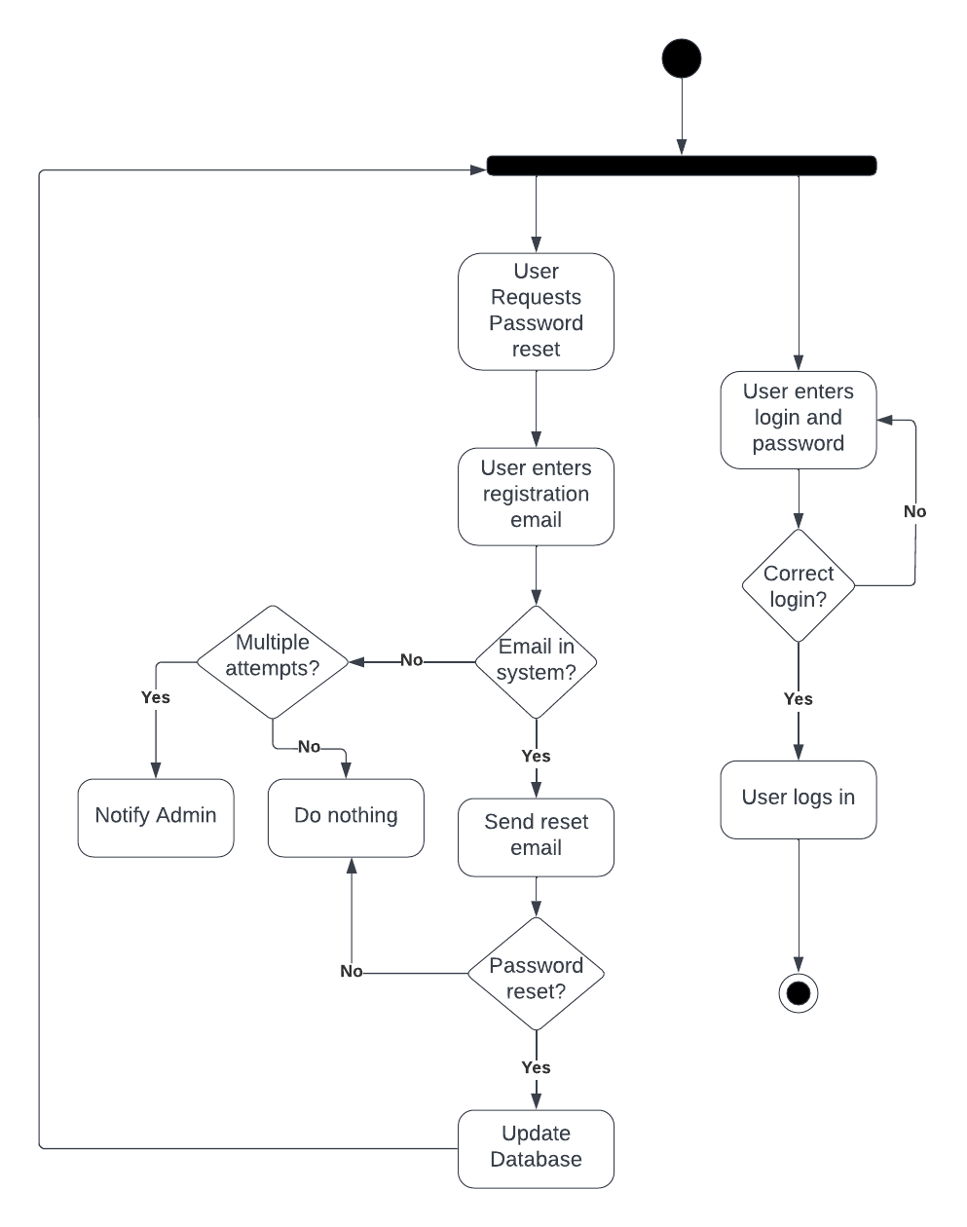
Activity Diagram
Notes:
Here is one of those bubbles from the previous slide, except here we broke it down into small tasks. Can anyone tell me what they think this is? Right! This is how we get into the login page. You can see here, if you remember your password, it is a really simple process to login. On the other hand, if you forget your password it gets a little more complicated. Let's break this down a little further. If you look on the right side, you can see a few things. First, a user is asked for their username and password. If it's right, the user successfully logs in and the process ends. If the user enters their password wrong, they are prompted for it. Now, let's look at the password reset process, first the user requests a password reset from the login page. The user then enters their registration email and password, and the system checks if the account is in our system. If the email is in our system, we send a reset email that allows the user to reset their password. If there is multiple attempts to reset a users password, the admin is notified. When the user resets the password, the database is updated and the user is prompted to login again.

Slide 5
Security
Login security
Passwords must contain a capital letter, number and character to combat brute force attacks.
Password reset preformed with registration email
2 factor authentication
Connection Security
HTTPS is used to prevent man-in-the-middle attacks between the client and server
Sensitive information stored in hash
Notes:
DriverPass implements many security features that you may have seen already in other systems. The primary focus is preventing users sensitive information from bad actors. How do we do this? It starts with the login process, specifically account creation. Adding a special character to your password helps prevent automated machines from guessing your correct password. 2 factor authentication is also an option. If you haven't used this before, basically a code is sent to your email when you login from a new device, and that code must be entered into driverpass in order to log in. Next we have connection security, I won’t talk too much about this, but rest assured, HTTPS will keep our users information safe in route to the server.

Slide 6
System Limitations
The system cannot support a large amount of users
Few months of initial development
The system can only be accessed through the internet
Notes:
So, we come to the part where we discuss what out system is not designed to do. First off, too many users would drive up the server costs, this would lower the ROI for Liam. Further, we need to push out this product fast, as development costs go up the more time we spend on it. The final limitation is that if we have no internet, access to the system is limited.

